Slide 1
Course Title: Data Mining
Course Code: PM-ASDS 18
Lecture-08: Association Rule (29.11.2024)
Presented by
Nasrin Khatun
Assistant Professor
Department of Statistics
Jahangirnagar University

Slide 2
Association Rule
Association Rule:
The purchasing of one product when another product is purchased represents an association rule.
Association rules are frequently used by retail stores to assist in marketing, advertising, floor placement, and inventory control.
It has also been used for predicting faults in telecommunication networks.
Association rules are used to show the relationships between data items. It is denoted by X ⇒Y
Example: Market Basket Data
Bread ⇒Peanut Butter
Objective: increase sales and reduce costs

Slide 3
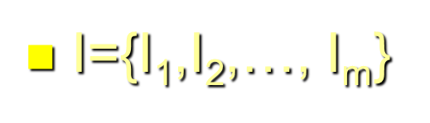
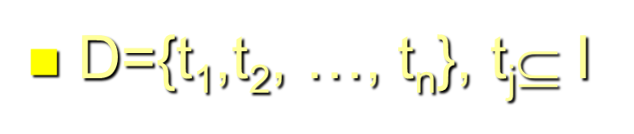
Association Rule
Items & Transactions:
When a customer buys some products from a retail store at one time, those products are known as items.
It is defined by
Here, one times mean one transaction and it is also defined by

Slide 4
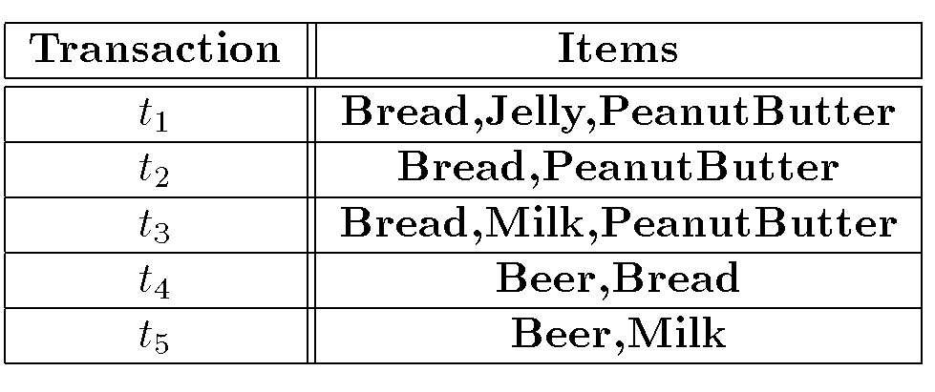
Association Rule
Items & Transactions (Example):

Slide 5

Association Rule(AR)
Support of an AR or X ⇒Y:
The supports for an association rule X ⇒Y is the percentage of transactions in the database that contain
It measures how often it should occur in the database.
It is denoted by “s”.
For example, if s=60% for Bread, means that for 100 transactions, customers buy 60 times Bread.

Slide 6
Association Rule(AR)
Confidence of an AR or X ⇒Y:
The confidence or strength (α) for an association rule X ⇒Y is the ratio of the number of transactions that contain X U Y to the number of transactions that contain X.
It Confidence measures the strength of the association rule.
It is denoted by “α”.
For example, if α=75% for Bread ⇒Peanut Butter, means that 75 percent times if customer buy bread and also buy peanut butter.

Slide 7

Calculation of Support & Confidence
From the given table, calculate support and confidence for Bread ⇒Peanut Butter.
Support= $\frac{No. of transactions with contain Bread}{Total no. of transactions}$ = $\frac{ 4}{5}$ = 80%
Confidence= $\frac{No. of transactions with contain Bread \& Peanut Better}{No. of transactions with contain Bread}$ = $\frac{ 3}{4}$ = 75%

Slide 8
Association Rule Problem
Given a set of items I={I₁,I₂,…,I_{m}} and a database of transactions D={t₁,t₂, …, t_{n}} where t_{i}={I_{i1},I_{i2}, …, I_{ik}} and I_{ij} ∈ I, the Association Rule Problem is to identify all association rules X ⇒ Y with a minimum support and confidence.
NOTE: Support of X ⇒ Y is same as support of X ∪ Y.

Slide 9
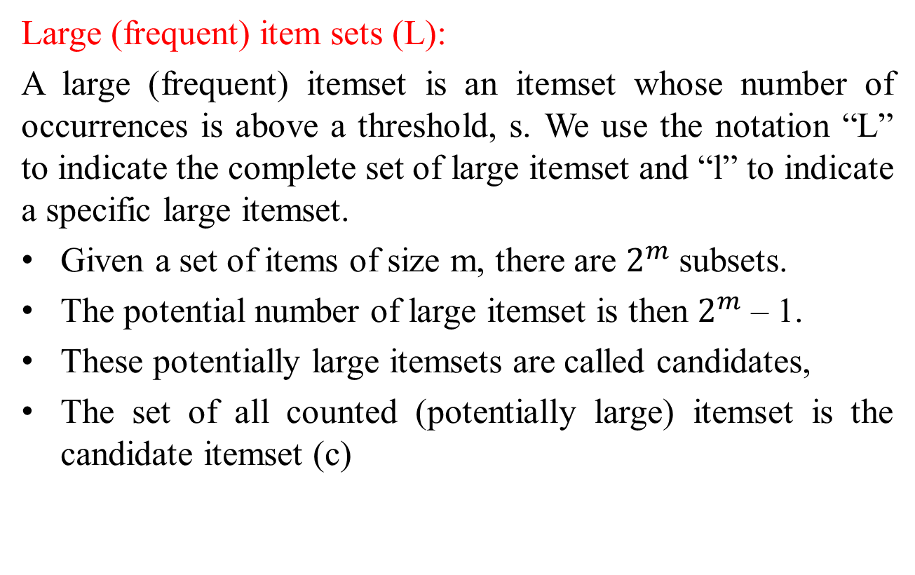
Association Rule Problem
Large (frequent) item sets (L):
A large (frequent) itemset is an itemset whose number of occurrences is above a threshold, s. We use the notation “L” to indicate the complete set of large itemset and “l” to indicate a specific large itemset.
Given a set of items of size m, there are $2^{m}$ subsets.
The potential number of large itemset is then $2^{m}$ – 1.
These potentially large itemsets are called candidates,
The set of all counted (potentially large) itemset is the candidate itemset (c)

Slide 10
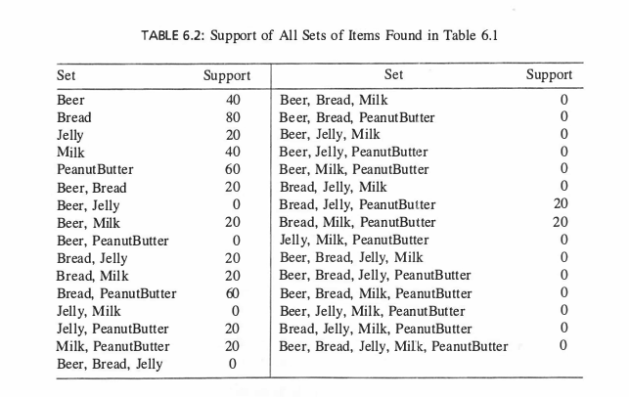
Large (frequent) item sets
From the given table, calculate the large itemset with support minimum 30%.
L={{Beer}, {Bread},{Milk},{Peanut Butter}{Bread, Peanut Butter}}

Slide 11
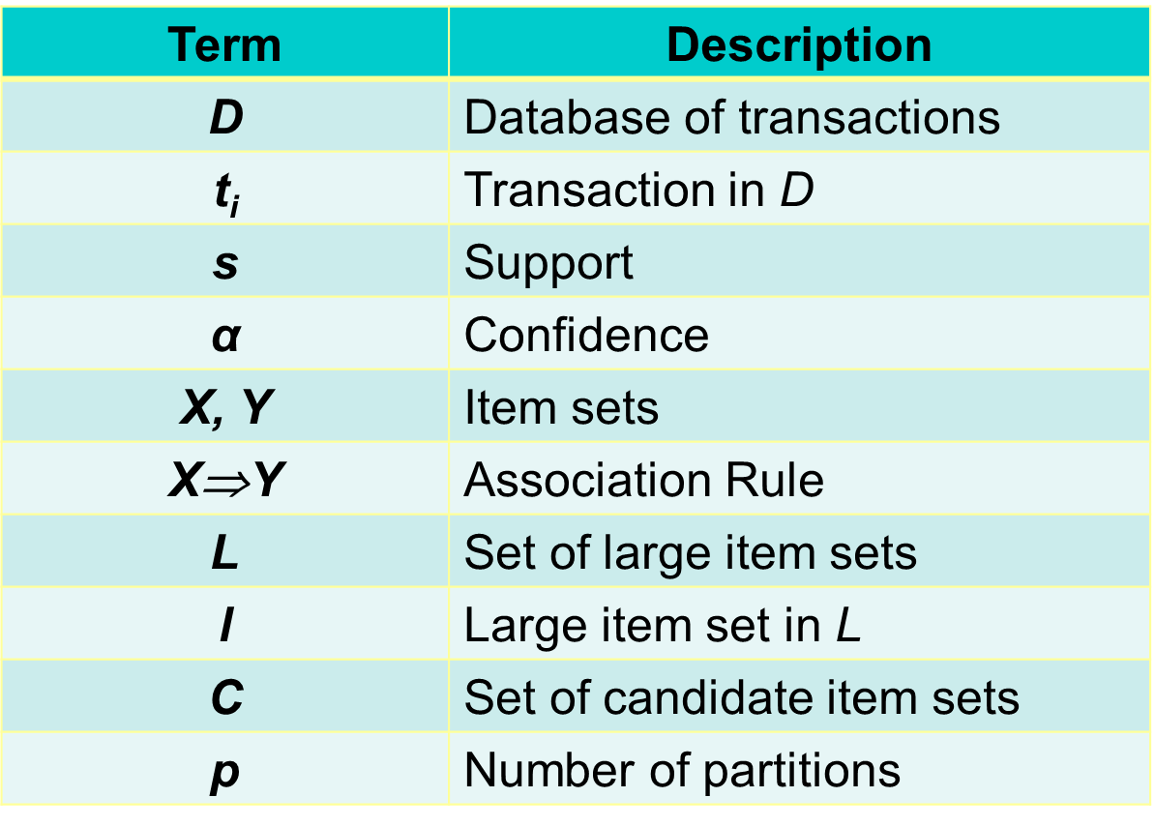
Different Notations

Slide 12
Basic Algorithms of AR
Apriori Algorithm
Sampling Algorithm
Partitioning Algorithm

Slide 13
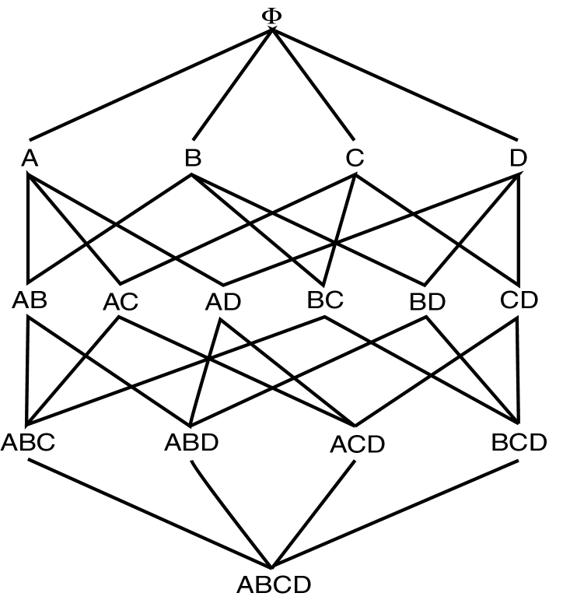
Apriori Algorithm
The Apriori algorithm is the most well known association rule algorithm and is used in most commercial products.
It uses the following property, which we call the large itemset property:
“Any subset of a large itemset must be large.”
These are said to be downward closer because it satisfies minimum support strategy.
For example, using Lattice method,

Slide 14
Apriori Algorithm
C₁ = Itemsets of size one in I;
Determine all large itemsets of size 1, L_{1;}
i = 1;
Repeat
i = i + 1;
C_{i} = Apriori-Gen(L_{i-1});
Count C_{i} to determine L_{i;}
Until no more specific large itemsets found;

Slide 15
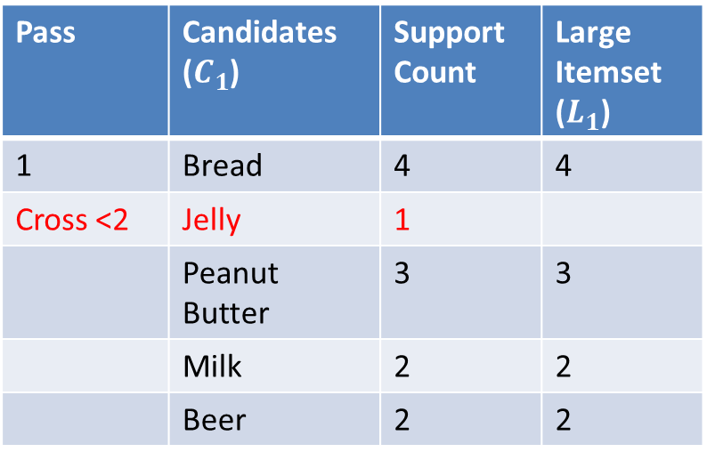
Apriori Algorithm
Find Large itemsets of below table using Apriori algorithm with minimum support 20%.
Pass | Candidates ($C_{1}$) | Support Count | Large Itemset ($L_{1}$)
1 | Bread | 4 | 4
Cross <2 | Jelly | 1
 | Peanut Butter | 3 | 3
 | Milk | 2 | 2
 | Beer | 2 | 2

Slide 16
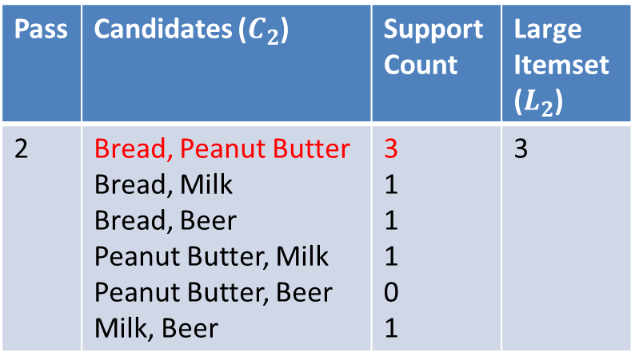
Apriori Algorithm
Find Large itemsets of below table using Apriori algorithm with minimum support 20%.
Pass | Candidates ($C_{2}$) | Support Count | Large Itemset ($L_{2}$)
2 | Bread, Peanut Butter Bread, Milk Bread, Beer Peanut Butter, Milk Peanut Butter, Beer Milk, Beer | 3 1 1 1 0 1 | 3

Slide 17
Apriori Algorithm
Advantages:
Uses large itemset property.
Easily parallelized
Easy to implement.
Disadvantages:
Requires up to m database scans.

Slide 18
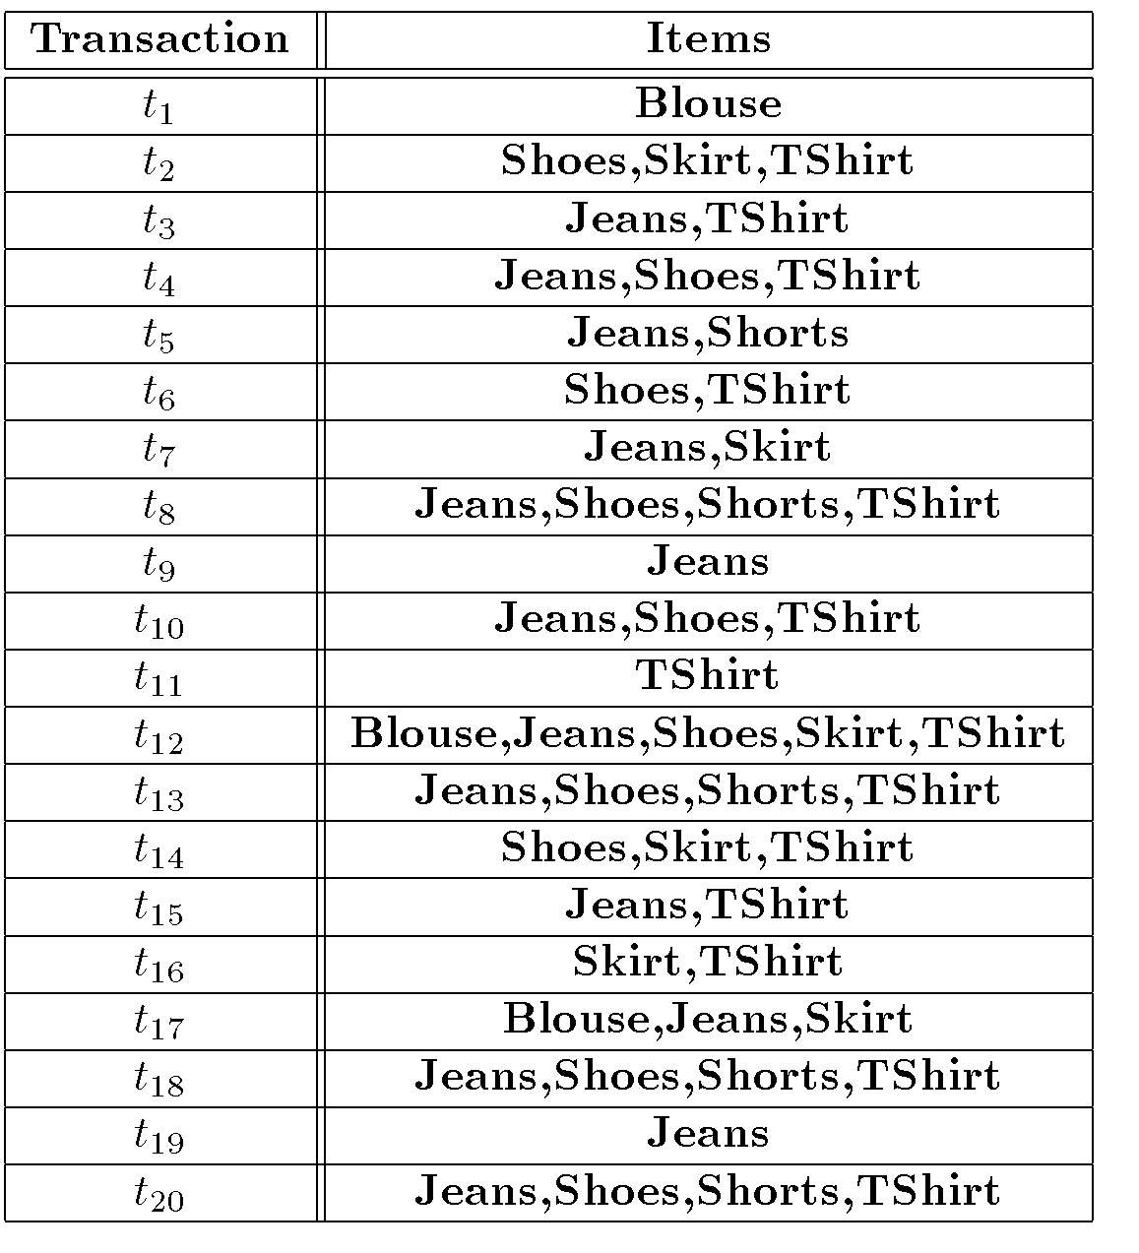
Apriori Algorithm
Example: Homework

Slide 19
Sampling Algorithm
Large databases
Sample the database and apply Apriori to the sample.
Potentially Large Itemsets (PL): Large itemsets from sample
Negative Border (BD ⁻ ):
Generalization of Apriori applied to itemsets of varying sizes.
Minimal set of itemsets which are not in PL, but whose subsets are all in PL.

Slide 20
Sampling Algorithm
D_{s} = sample of Database D;
PL = Large itemsets in D_{s} using smalls;
C = PL ∪ BD⁻(PL);
Count C in Database using s;
ML = large itemsets in BD⁻(PL);
If ML = ∅ then done
else C = repeated application of BD^{-;}
Count C in Database;

Slide 21
Sampling Algorithm (Example)
Question: We use the sampling algorithm to find all large itemset in the grocery data where s = 20%. Suppose that the sample database is determined to be the first two transactions: Ds = t₁ = {Bread Jelly, Peanut Butter} t₂ = {Bread, Peanut Butter}. If we reduce s to be smalls = 10%, then for an itemset to be large in the sample it must occur in at least one to two transactions. So it must occur in one of the two transactions.
Solution:
Find AR assuming s = 20%
D_{s} = { t₁,t₂}
Smalls = 10%
PL = {{Bread}, {Jelly}, {Peanut Butter}, {Bread, Jelly}, {Bread, Peanut Butter}, {Jelly, Peanut Butter}, {Bread, Jelly,Peanut Butter}}
BD⁻(PL)={{Beer},{Milk}}
ML = {{Beer}, {Milk}}
Repeated application of BD⁻ generates all remaining itemsets.

Slide 22
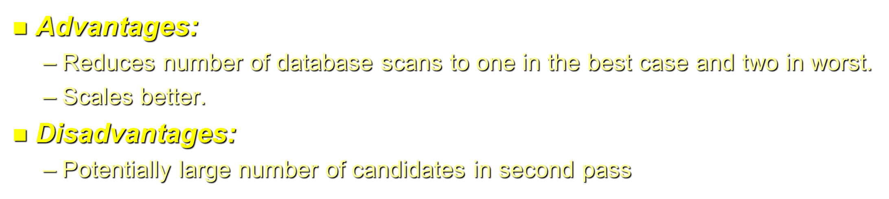
Sampling Algorithm (Example)

Slide 23
Partitioning
Divide database into partitions D¹,D²,…,D^{p}
Apply Apriori to each partition
Any large itemset must be large in at least one partition.

Slide 24
Partitioning Algorithm
Divide D into partitions D¹,D²,…,D^{p;}
For I = 1 to p do
L^{i} = Apriori(D^{i});
C = L¹ ∪ … ∪ L^{p};
Count C on D to generate L;

Slide 25
Partitioning Algorithm (Example)
L¹ ={{Bread}, {Jelly}, {PeanutButter}, {Bread,Jelly}, {Bread,PeanutButter}, {Jelly, PeanutButter}, {Bread,Jelly,PeanutButter}}
D¹
L² ={{Bread}, {Milk}, {PeanutButter}, {Bread,Milk}, {Bread,PeanutButter}, {Milk, PeanutButter}, {Bread,Milk,PeanutButter}, {Beer}, {Beer,Bread}, {Beer,Milk}}
D²
S=10%

Slide 26
Partitioning Algorithm (Example)
Advantages:
Adapts to available main memory
Easily parallelized
Maximum number of database scans is two.
Disadvantages:
May have many candidates during second scan.

Slide 27
Parallel Algorithm of AR
Count Distribution Algorithm:
Data Distribution Algorithm

Slide 28
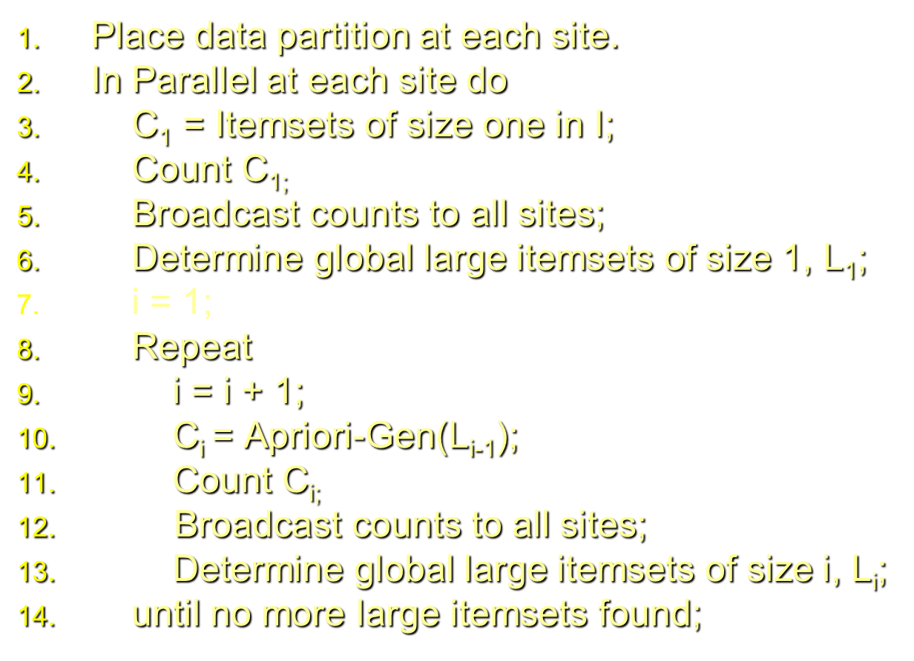
Parallel Algorithm of AR
Count Distribution Algorithm:

Slide 29
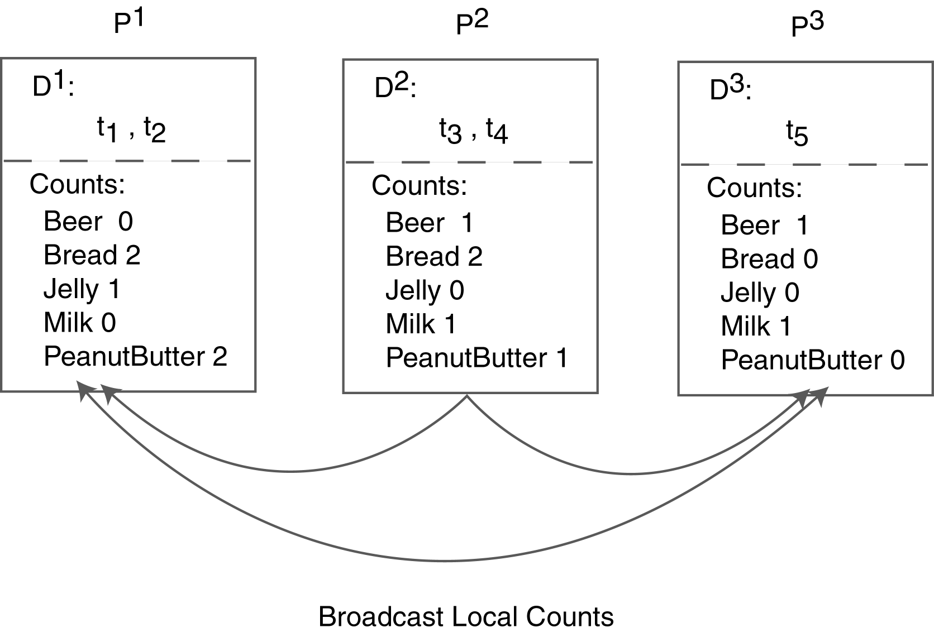
Parallel Algorithm of AR(CDA)
Count Distribution Algorithm:

Slide 30
Parallel Algorithm of AR
Data Distribution Algorithm:
Place data partition at each site.
In Parallel at each site do
Determine local candidates of size 1 to count;
Broadcast local transactions to other sites;
Count local candidates of size 1 on all data;
Determine large itemset of size 1 for local candidates;
Broadcast large itemset to all sites;
Determine L₁;
i = 1;
Repeat
i = i + 1;
C_{i} = Apriori-Gen(L_{i-1});
Determine local candidates of size i to count;
Count, broadcast, and find L_{i};
until no more large itemset found;

Slide 31
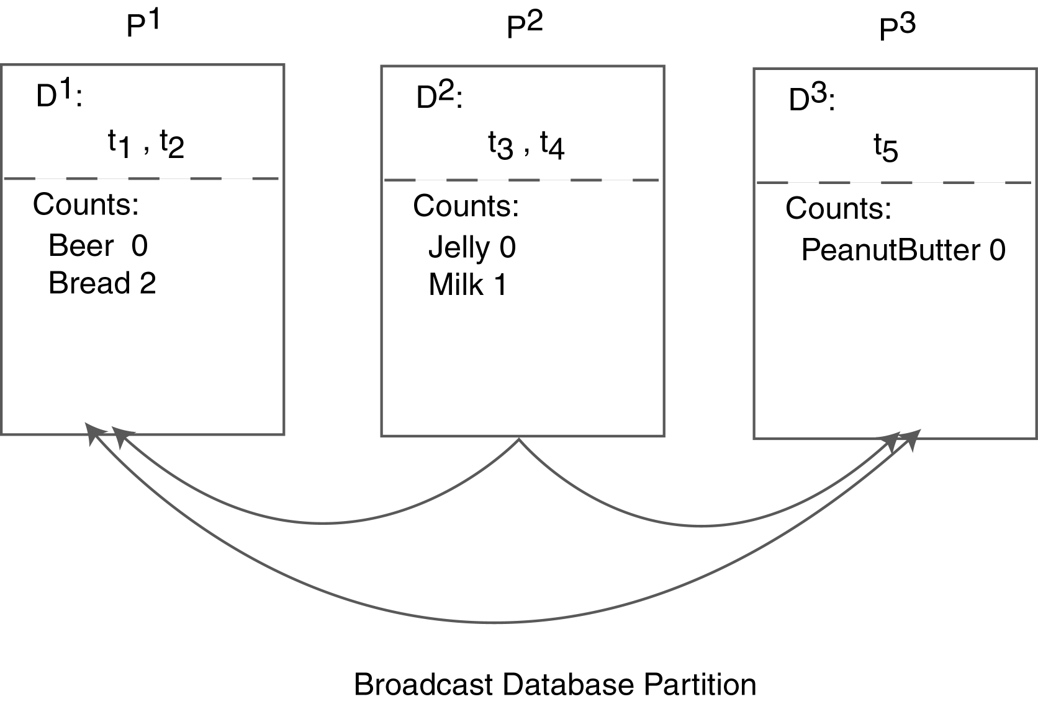
Parallel Algorithm of AR (DDA)

Slide 32
Comparing AR Techniques
Target
Type
Data Type
Data Source
Technique
Itemset Strategy and Data Structure
Transaction Strategy and Data Structure
Optimization
Architecture
Parallelism Strategy

Slide 33
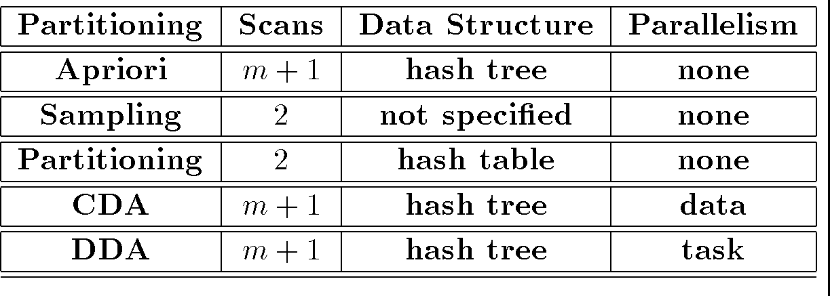
Comparing AR Techniques

Slide 34
Advanced AR Techniques
Generalized Association Rules
Multiple-Level Association Rules
Quantitative Association Rules
Using multiple minimum supports
Correlation Rules

Slide 35
Measuring Quality of Rules
Support
Confidence
Interest or Lift
Conviction
Chi Squared Test
These yellow marked three calculated from Contingency table.

Slide 36
Association Rule
END

